Slide 1
Detecting and Mitigating Semantic Drift
in Multi-Turn Instruction-Based Image Editing
R. W. V. Imansha Dilshan
Software Engineering Teaching Unit
University of Kelaniya
Undergraduate Research Project - Final Defense

Slide 2
MOTIVATION
Editors follow the instruction. What else do they change?
- Instruction-based editors (InstructPix2Pix) let users refine an image turn by turn:
• "make the sky sunset" then "add a bird" then "remove the fence"
- A model can follow every single instruction correctly, and still drift further and
- further from what the user wanted, because nothing constrains it to leave the rest
- of the image alone.
- Existing evaluation (CLIP scores, human preference studies) checks whether the
- requested change happened. None of it checks what else changed as a side effect.
This project calls that side effect semantic drift, and asks whether it can be
measured automatically and reduced cheaply.
Detecting and Mitigating Semantic Drift in Multi-Turn Instruction-Based Image Editing
2 / 17

Slide 3
SCOPE
Three research questions
Can unintended drift be measured automatically,
RQ1
without manually inspecting every edited image?
Does drift accumulate as an edit chain gets longer,
RQ2
so later instructions cause more collateral damage than earlier ones?
Can cheap, pretrained-model-only interventions
RQ3
reduce that drift?
Uses only pretrained models: no training or fine-tuning of any editing model.
Detecting and Mitigating Semantic Drift in Multi-Turn Instruction-Based Image Editing
3 / 17

Slide 4
RELATED WORK
What prior approaches do not measure
Prompt-to-Prompt / Plug-and-Play / MasaCtrl / Null-text Inv.
Produce a more consistent single edit
Emu Edit / HIVE
Improve whether the requested edit happened
MagicBrush
Multi-turn data, but only checks the target region changed correctly
This work (Drift Score)
Measures unintended change, across a chain, with mitigations compared
Detecting and Mitigating Semantic Drift in Multi-Turn Instruction-Based Image Editing
4 / 17

Slide 5
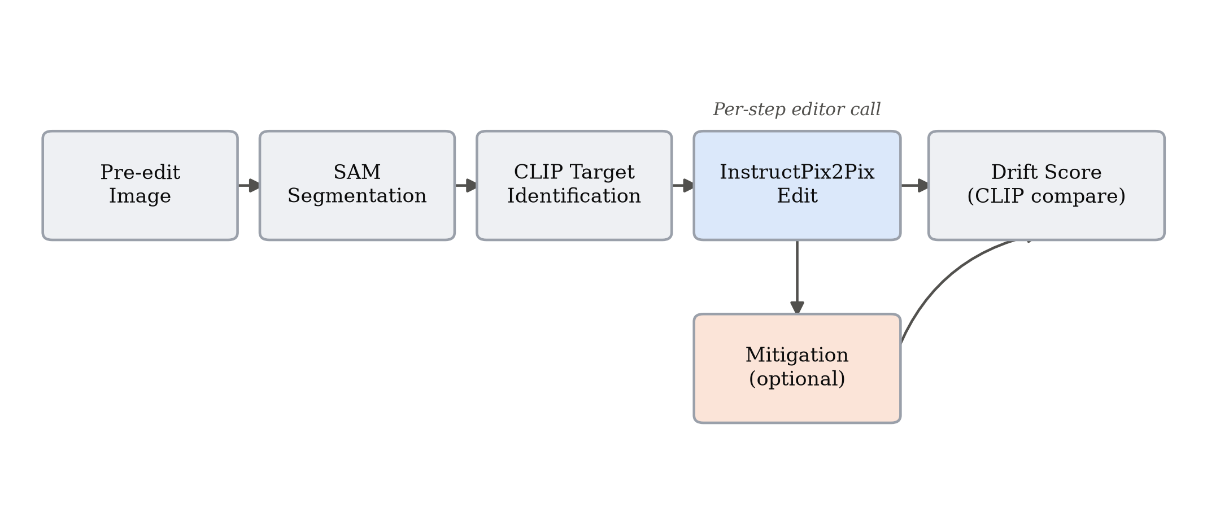
METHODOLOGY
The Drift Score
- Segment the pre-edit image with SAM into regions.
- Identify the target region: the box CLIP finds most similar to the instruction text.
- For every OTHER (non-target) region, measure 1 minus CLIP cosine similarity between
• its pre-edit and post-edit crop.
- Per-step Drift Score = mean drift over non-target regions.
- Cumulative Drift Score = sum of per-step scores across a chain. Higher = more
• unintended change accumulated.
Detecting and Mitigating Semantic Drift in Multi-Turn Instruction-Based Image Editing
5 / 17

Slide 6
METHODOLOGY
Dataset: 120 four-step edit chains
60
120
480
COCO val2017 images
edit chains, 4 steps each
individual edit instructions
- Chain A (object-level): 4 localized, single-object edits per image
• e.g. change a horse's color, then remove an obstacle in front of it
- Chain B (global): 4 broad, scene-level edits per image
• e.g. make the scene rainy, then add sunset lighting
- Every image inspected individually and hand-written, not template-generated
- Instruction verbs (all 480): change 108, add 114, remove 60, global/stylistic 198
• (hand-written by a single author, a stated bias, not crowd-sourced)
Detecting and Mitigating Semantic Drift in Multi-Turn Instruction-Based Image Editing
6 / 17

Slide 7
METHODOLOGY
Two mitigation strategies
Region-Locking
Masked Conditioning
- Run the edit on the full image as usual.
- Revert every pixel outside the target region's box back to the pre-edit image.
- A correction applied AFTER generation.
- Crop the image to the target region, plus a 32-pixel context margin.
- Generate the edit only on that crop.
- Paste the result back into the full frame. The model never sees the rest of the
• image, a constraint applied AT generation time.
Both use the identical SAM + CLIP target-region procedure the Drift Score itself uses.
Detecting and Mitigating Semantic Drift in Multi-Turn Instruction-Based Image Editing
7 / 17

Slide 8
METHODOLOGY
A second, independent check: Edit Adherence Score
- Low unintended change only matters if the requested edit still happened.
- Edit Adherence Score = whole-image CLIP similarity between the final image and the
• final instruction's text.
- Computed identically for all three conditions, with no region segmentation at all,
- so it cannot inherit the target-box definition the Drift Score and region-locking share.
Why this matters: region-locking's low drift score is EXPECTED almost by definition,
since it reverts pixels using the same box the score excludes. This metric answers
that concern directly, with independent evidence.
Detecting and Mitigating Semantic Drift in Multi-Turn Instruction-Based Image Editing
8 / 17

Slide 9
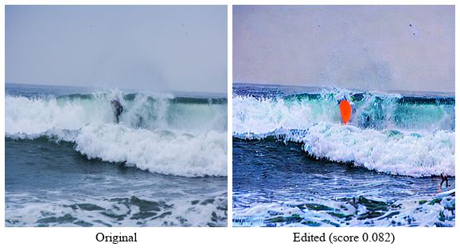
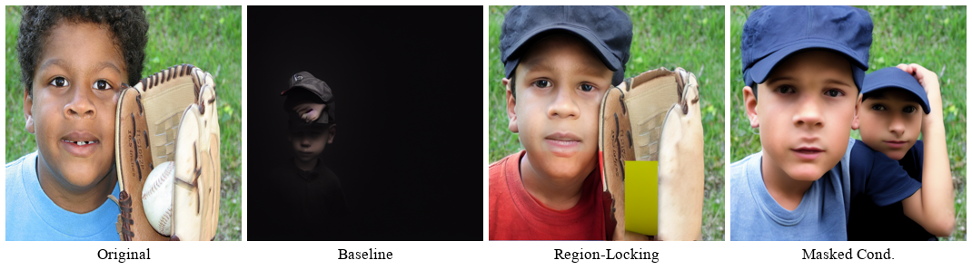
RESULTS - RQ1
Does the score agree with what the eye sees?
Lowest-scoring chain (0.082): only the outfit and
surfboard color change; wave, spray, and sky untouched.
Highest-scoring chain (0.565): a severe editing
failure, collapses to near-black by step 3.
The metric correctly ranks the best and worst chains in the dataset, agreement between the
number and visible content that a purely statistical validation cannot substitute for.
Detecting and Mitigating Semantic Drift in Multi-Turn Instruction-Based Image Editing
9 / 17

Slide 10
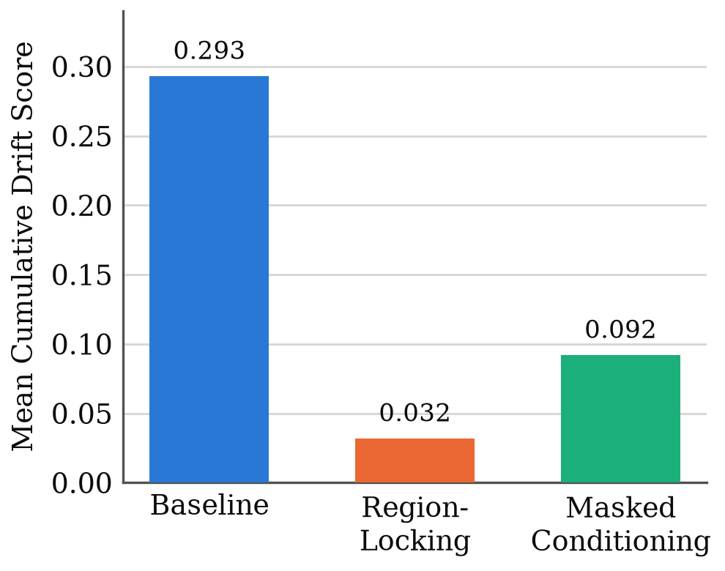
RESULTS - RQ3
Both mitigations cut drift by a wide margin
Condition
Mean
Reduction
p
dz
Baseline
0.293
-
-
-
Masked Cond.
0.092
68.6%
<0.0001
1.73
Region-Locking
0.032
89.1%
<0.0001
2.68
Region-locking also beats masked conditioning
directly (p<0.0001, dz=1.05). Rank-biserial
correlation = 1.00: every one of 120 paired
chains favored region-locking.
Detecting and Mitigating Semantic Drift in Multi-Turn Instruction-Based Image Editing
10 / 17

Slide 11
RESULTS
Real, but modest, cost to instruction-following
Condition
CLIP Score
vs. Baseline
p
dz
Baseline (pre-edit)
0.230
-
-
-
Baseline
0.245
-
-
-
Masked Conditioning
0.225
-0.020
<0.0001
-0.51
Region-Locking
0.217
-0.028
<0.0001
-0.68
- Both mitigations do cost real instruction-adherence (p<0.0001, not zero).
- But the cost's effect size (dz 0.51 to 0.68) is under half the size of the matching
• drift-reduction effect size (dz 1.73 to 2.68).
- A genuine, quantified trade-off that favors both mitigations, not a free lunch,
• and not circular reasoning either.
Detecting and Mitigating Semantic Drift in Multi-Turn Instruction-Based Image Editing
11 / 17

Slide 12
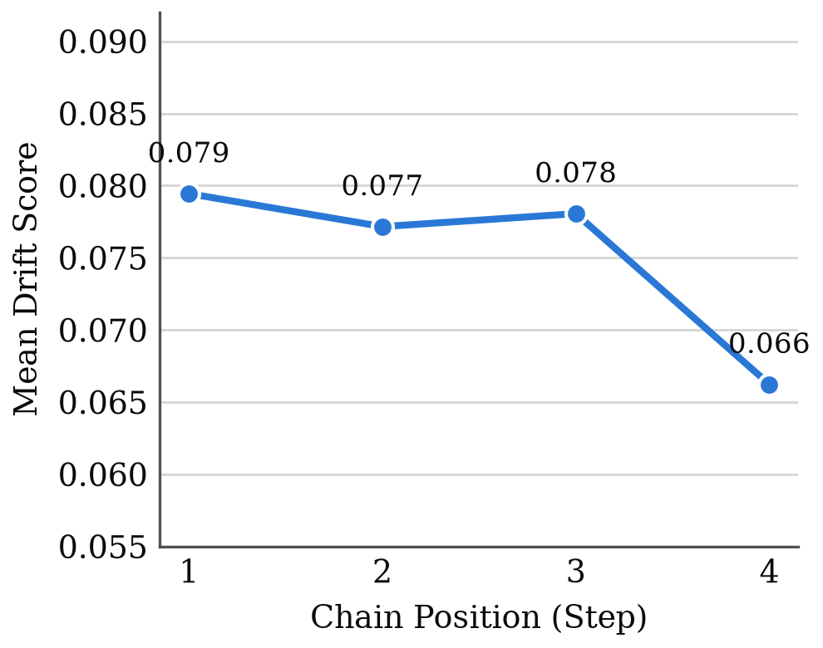
RESULTS - RQ2
Drift did not compound the way we expected
- No single consecutive step transition is significant
• (1→2: p=0.85, 2→3: p=0.33, 3→4: p=0.47)
- Step 1 vs. step 4 IS significant (p=0.012), but
• step 4 shows LESS drift than step 1, the reverse
• of the predicted direction
- Explanation: a chain that collapses catastrophically
• early has little room left to register as further
• changed, a measurement ceiling effect, not proof
• that later edits are genuinely gentler
Detecting and Mitigating Semantic Drift in Multi-Turn Instruction-Based Image Editing
12 / 17

Slide 13
DISCUSSION
Two hypotheses reversed. Both have a mechanism.
H2: masked conditioning was predicted to beat region-locking. It didn't.
Masked conditioning edits a padded crop (target box + 32px margin) that the Drift
Score does NOT exclude from scoring, so its own padding ring counts as drift even
when nothing objectionable happened there. Region-locking's hard revert has no
equivalent margin.
H1: drift was predicted to compound across the chain. It didn't, measurably.
A shared weak point for both mitigations: CLIP target-region identification is
unreliable for "add X" instructions, since nothing pre-existing matches well. One
traced failure: an "add a cap" box covered 99.6% of the frame, giving neither
mitigation a meaningful constraint on that step.
Detecting and Mitigating Semantic Drift in Multi-Turn Instruction-Based Image Editing
13 / 17

Slide 14
LIMITATIONS
Seven constraints on the present study
- 60-image, 120-chain dataset: an initial empirical study, not a definitive benchmark
- Instructions hand-written by a single author, not crowd-sourced (a stated bias)
- All results specific to InstructPix2Pix; model-agnosticism is a design goal, untested
- CLIP similarity is an imperfect proxy for human-perceived change
- The human-rating tool (15 stratified chains) was built but not administered
- Target-region identification is a known weak point for "add" instructions
- Attention-restricted editing was scoped but not implemented (RQ3 answered without it)
Detecting and Mitigating Semantic Drift in Multi-Turn Instruction-Based Image Editing
14 / 17

Slide 15
CONCLUSION
RQ1 and RQ3: yes. RQ2: more interesting than yes/no.
- RQ1: unintended drift CAN be measured automatically, and the metric agrees with
• visible content on both the best and worst chains in the dataset.
- RQ3: cheap, pretrained-model-only mitigations DO work. Region-locking cuts drift
• 89.1%, masked conditioning 68.6%, both p<0.0001, both large effect sizes.
- RQ2: no reliable evidence of compounding. Drift instead looks front-loaded into
• occasional catastrophic failures, a distinct and equally useful finding.
- Two specific mechanisms explain both reversed hypotheses, evidence the metric
• captures something real and interpretable, not noise.
Detecting and Mitigating Semantic Drift in Multi-Turn Instruction-Based Image Editing
15 / 17

Slide 16
FUTURE WORK
Next steps toward a benchmark
- Run the built human-perceptual check to validate the Drift Score and the Edit
• Adherence Score against human judgment on the same 15 chains.
- Evaluate the Drift Score against a second, more recent editor, to test the
• model-agnosticism claimed but not exercised here.
- Design a metric less prone to the ceiling effect, sensitive to further degradation
• of an already-degraded image, to separate gradual compounding from sudden failure.
Detecting and Mitigating Semantic Drift in Multi-Turn Instruction-Based Image Editing
16 / 17

Slide 17
Thank you
Questions?
Code, dataset, and full paper: github.com/imanshadilshan/semantic_drift

